Slide 1
SENSITIVE DATA PROTECTION USING MULTILAYERED APPROACH
GAYATHRI S NAIR
MCA A
ROLL NO:50

Slide 2
Relevance
Security is one of the main challenges for the implementation of computing for many service based companies.
It is possible that a file with sensitive information can get corrupted or damaged.
Once we upload a file in public domains, we should check whether the file is corrupted or not.
So it is important to consider the need for protection of sensitive data .

Slide 3
Description
This model consists of mainly 3 levels of authorization :
Authorization Level
Encryption
Auditor.
The model uses encryption to secure the files present in our system. A user can verify their account using username and password. The auditor can check whether a file is corrupted or not.
In this system the data in files are encrypted. This method leads to protect our data from penetration or exposure to viruses. The data is not exposed to theft or breach, and messages exchanged in the system environment will be protected.

Slide 4
Objectives
To ensure security and privacy for storing sensitive information
To enable users to know whether the data is corrupted or not through auditor.
Auditing the file and replace the corrupted ones thus implementing more security.

Slide 5
Existing System
The existing system implements a environment for storing data and records.
It doesn't guarantee the protection of data and content within.
If a file is stored long back say 2020, the user cannot know whether it is damaged or not unless he/she goes and check the file in the system which is a tedious task.
Data is prone to malicious attacks and threats.

Slide 6
Proposed System
The proposed system adds an extra layer of security
Files are stored in an encrypted format.
We can upload any type of file;text,image etc.
More secure compared with the existing system.
Auditing helps to restore damaged files and records.

Slide 7
Modules
ADMIN
USER
AUDITOR
STORAGE/SHARING
ENCRYPTION

Slide 8
Methodology
There are mainly 3 types of users namely ADMIN,USER and AUDITOR.
USER:
The User here denotes a typical user.He/She can upload a file from their system.
The file uploaded will be in an encrypted format.
It is encrypted using AES encryption algorithm.
Advanced Encryption Standard (AES) is a block cipher.
Once the file is uploaded, the user can sent request for auditing the file.

Slide 9
AUDITOR
Once the auditor receives the request,he/she should send access permission request to the user for accessing the file.
The user needs to send the original file and the auditor compares the original file with the file present with the auditor.
The Auditor compares the files and analyze the files using the signature and batch comparison.
The signature is generated using SHA algorithm.
Secure Hashing Algorithm is a cryptographic hash function which takes an input and produces a 160-bit hash value.
If the signature and the data of the both files matches the files are secure oitherwise the auditor can replace the file.

Slide 10
FRONT END AND BACK END TOOLS
FRONT END: HTML,CSS,JAVASCRIPT
BACK END : PYTHON,DJANGO
DJANGO: Django is a back-end server side web framework. Django is free, open source and written in Python. Django makes it easier to build web pages using Python.

Slide 11

Screenshots

Slide 12
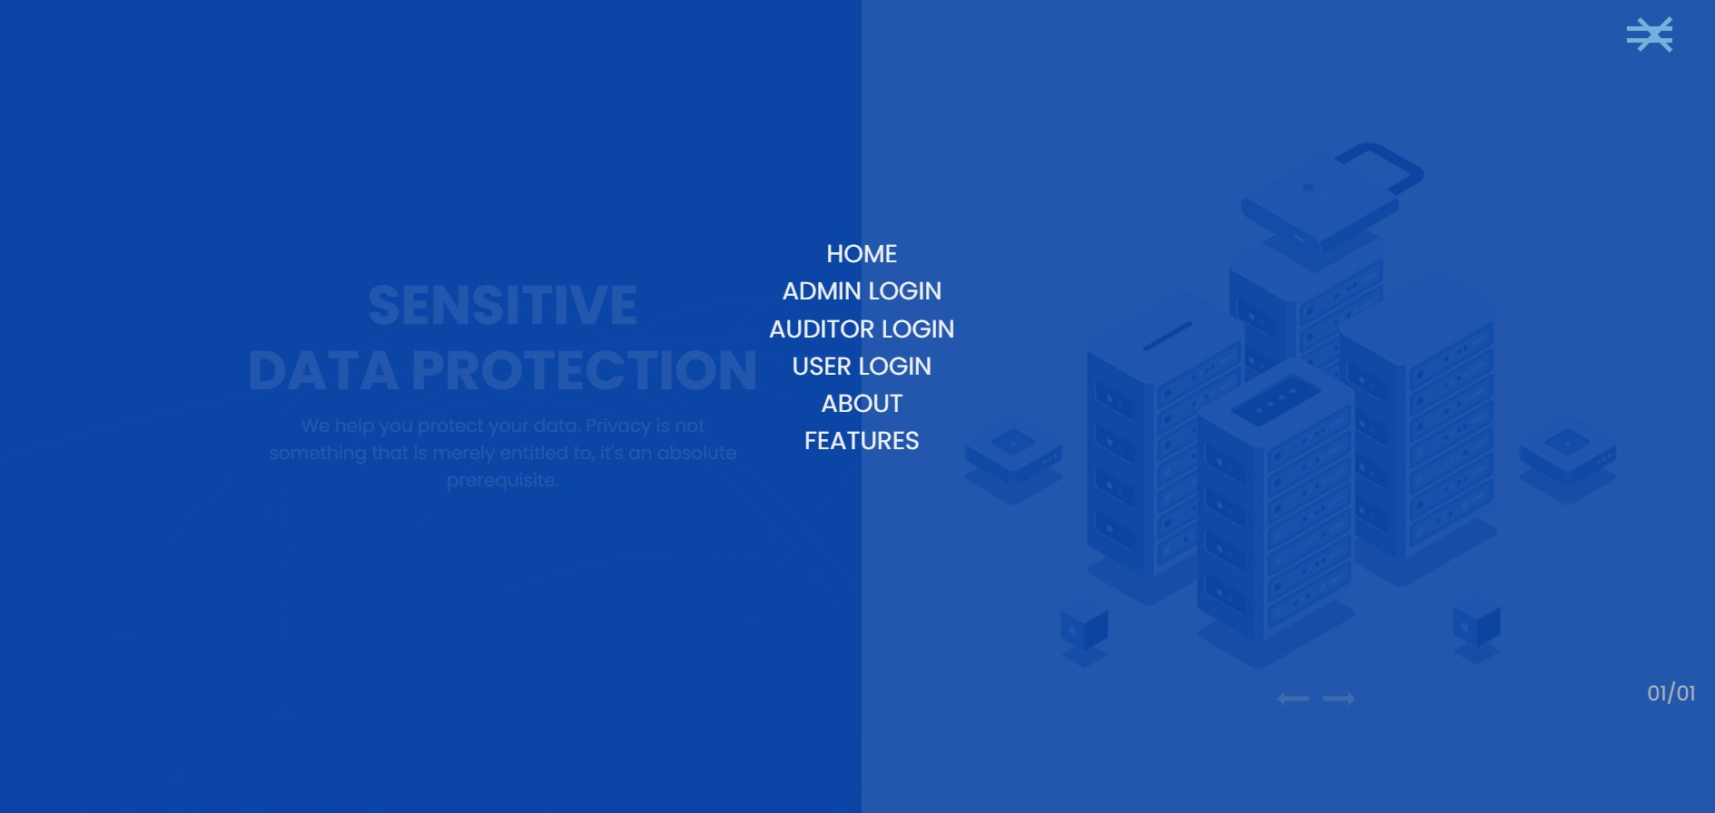

Slide 13
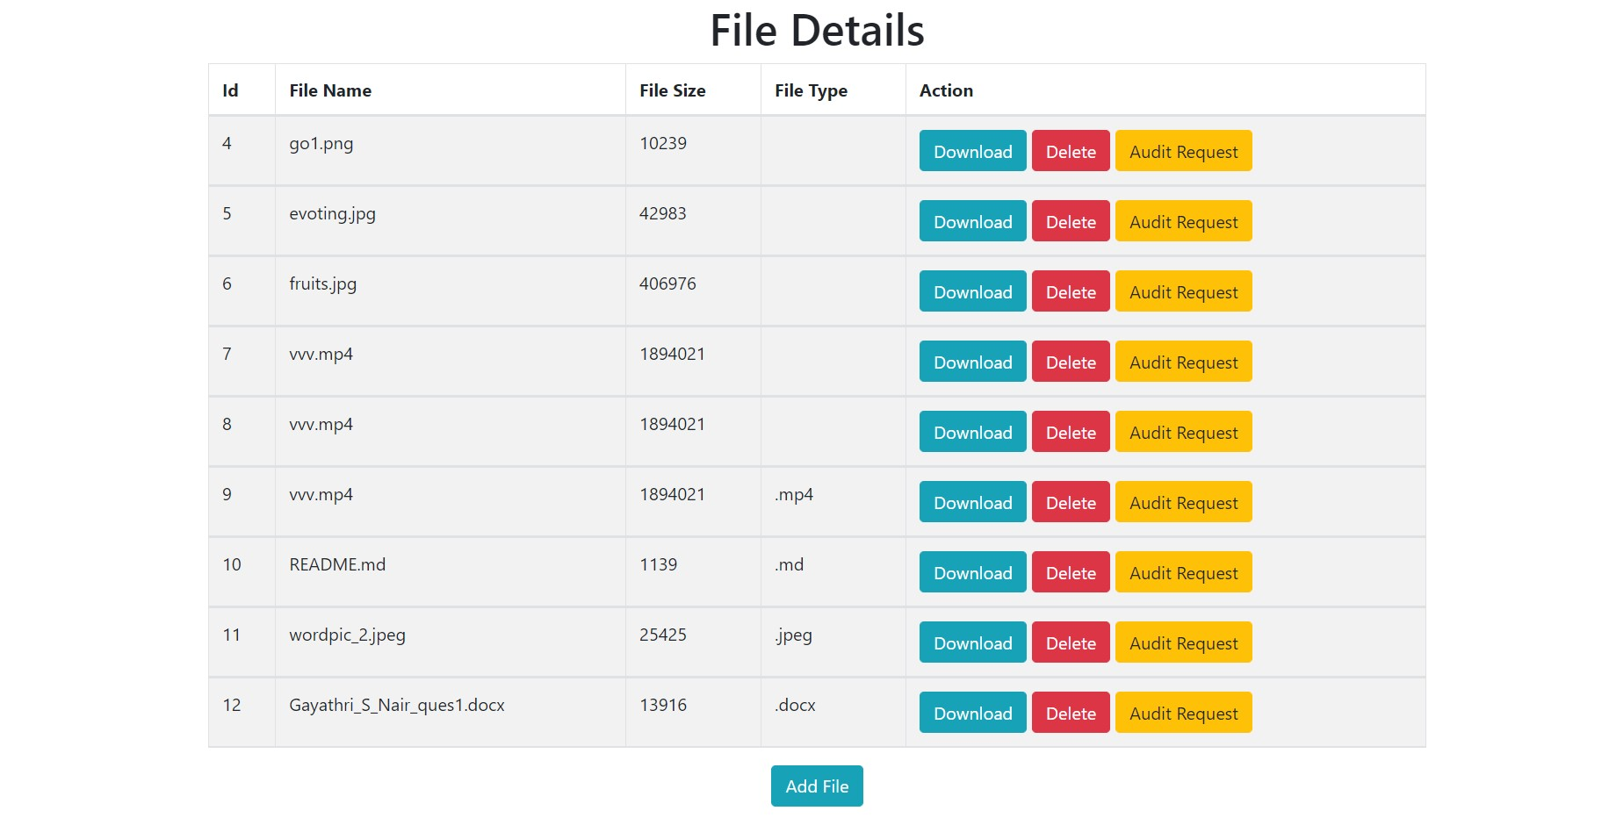

Slide 14
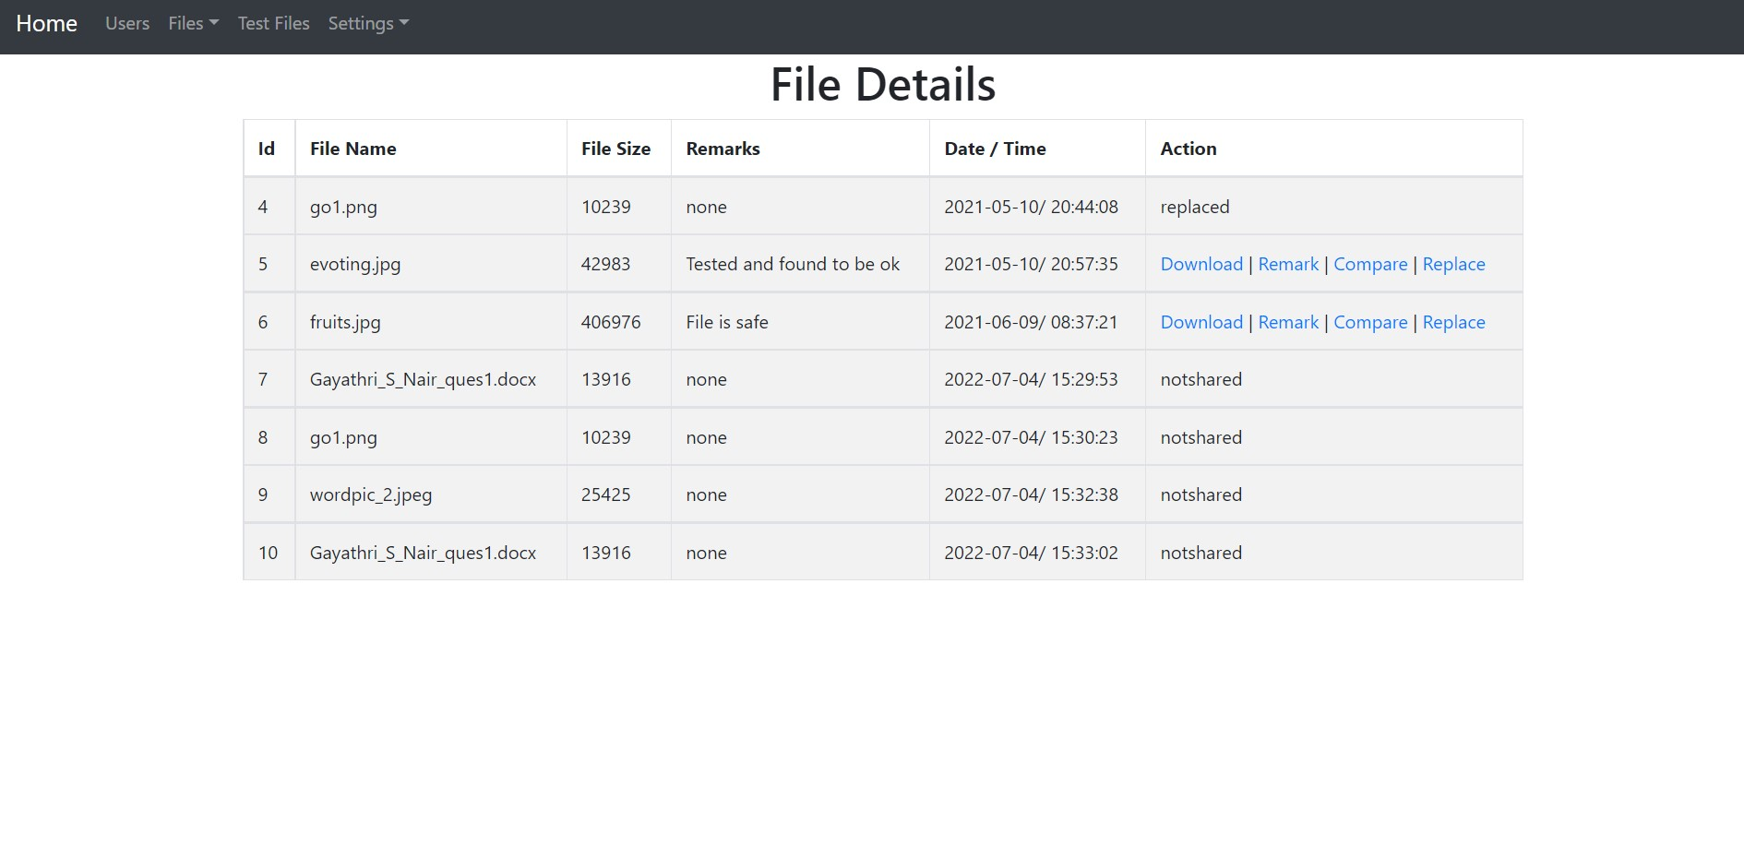

Slide 15
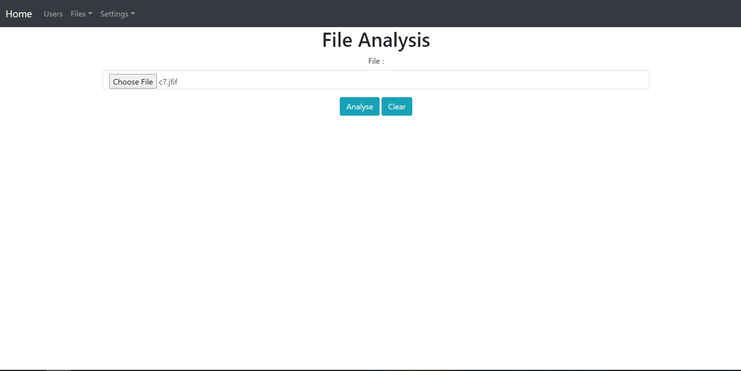

Slide 16
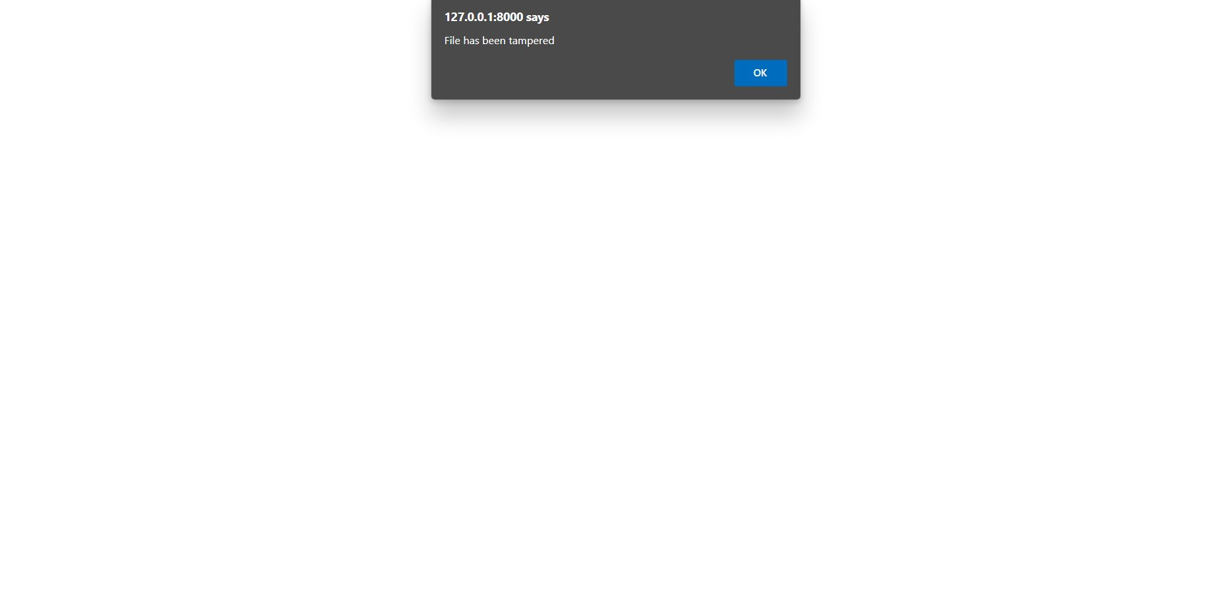

Slide 17
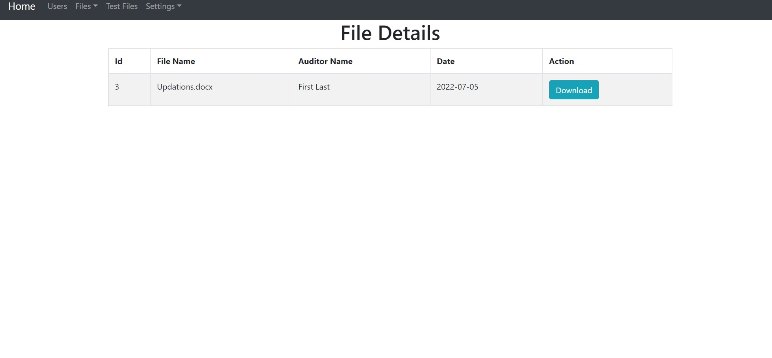

Slide 18
